Slide 1
Snails, Paper, and Programming
A Computational Approach to Mollusc Morphology in Origami
Notes:
HMC is known for its Interdisciplinary approach with a … concentration in humanities… like art.
I wanted to see how many different disciplines I could fit into a short talk.
One that I didn’t really need to prepare for because it was something I know well and work on already..
Slides are available, as are origami patterns.
You have to provide your own paper.
And your own snails.

Slide 2

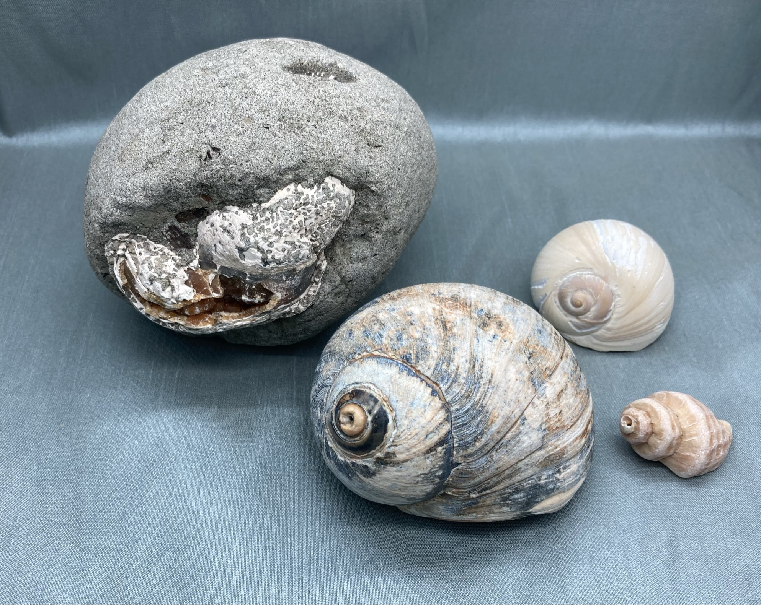
Snails
Ok, all molluscs with shells.
But not cephalopods.
Notes:
(Show shells live)
Let’s start with snails. Well shells.
Let’s do some terms because I’m going to use them and forget you might not know them.
Planispiral (curves in on itself like a nautilus)
Turbinate (curves off to the side like a snail, conical)
Revolutions
Whorls are the physical representation of those revolutions
Protoconch (tip, apex, first shell of the baby snail)
Body whorl (last, largest opening)
Septa (interior lines between whorls)… these are wholly internal

Slide 3
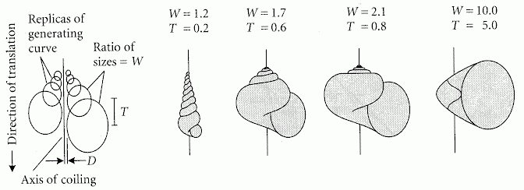
Computer as Aid in Describing Form in Gastropod Shells Raup, 1962
W: size ratio of successive generating curves
D: distance of the generating curve from the axis,
T: proportion of the height of one generating curve that is covered by each subsequent turn.
Notes:
Shells are great for evolution because they already live in the mud so they get fossilized easily.
Needed ways to describe shells so they could only name newly discovered species after their kids and significant others
There were ways before this but nothing so elegant. More importantly, check out that paper name… computers in 1962.
Imagine how many punchcards this paleontologist dealt with.
I’m not going to read what the parameters means, the two that you need to know are W which is about how fast the whorls get bigger, and T which is how much whorls get covered as it gets bigger.
So going back to our terms, planispiral, like a nautilus that curves in on itself, has a large T
Where turbinate or conical shells have a lower T, allowing them to have pointy ends.
In turbinate, you can see the protoconch but in planispiral you can’t.
Revolutions are well, revolutions around the axis of coiling. Whorls are the evidence of the revolutions.
Revolutions
Whorls
Protoconch (tip, apex, first shell of the baby snail)
Body whorl (last, largest opening)
Septa (interior lines between whorls)

Slide 4
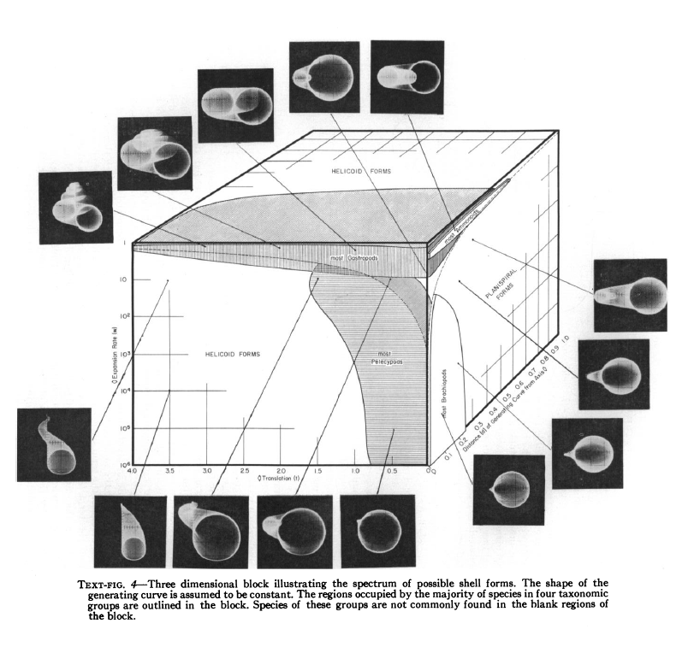
Geometric Analysis of Shell Coiling
Raup, 1966
Notes:
It is really weird how many of the parameters have been filled throughout out the geologic record, a lot like nature tries all the options.
It makes me wonder how nature does the functions, what key pieces, probably enzymes, change the function.
So that is the start of snails…

Slide 5
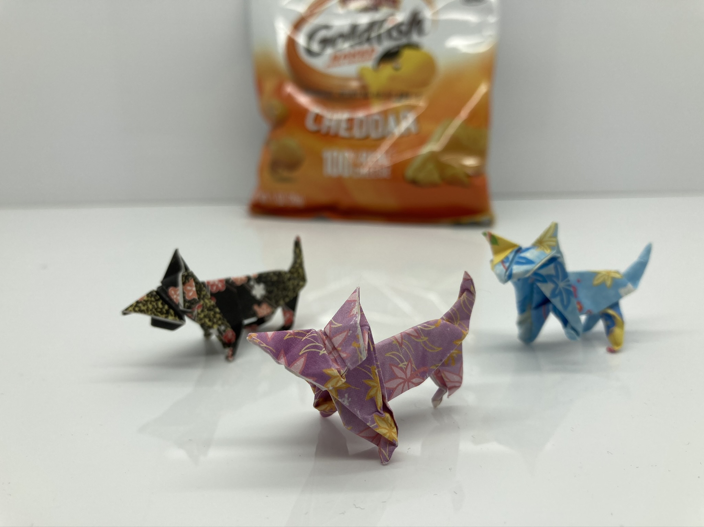
Paper
It started with cats.
As usual.
Notes:
Moving on to paper.
I concentrated in art while at Mudd. I mostly did pottery but
Abstract drawing
Sketching nature
And technical comics have all been part of my life.
I like origami but it wasn’t an obsession
Until about two years ago when I needed to fold a really good origami cat so I could put in an electronic purring mechanism.
Anyway, I folded hundreds of cats and I started to understand that origami isn’t about successfully folding a 57-step dragon
but folding the dragon over and over until you understand it. A lot like calculus.

Slide 6
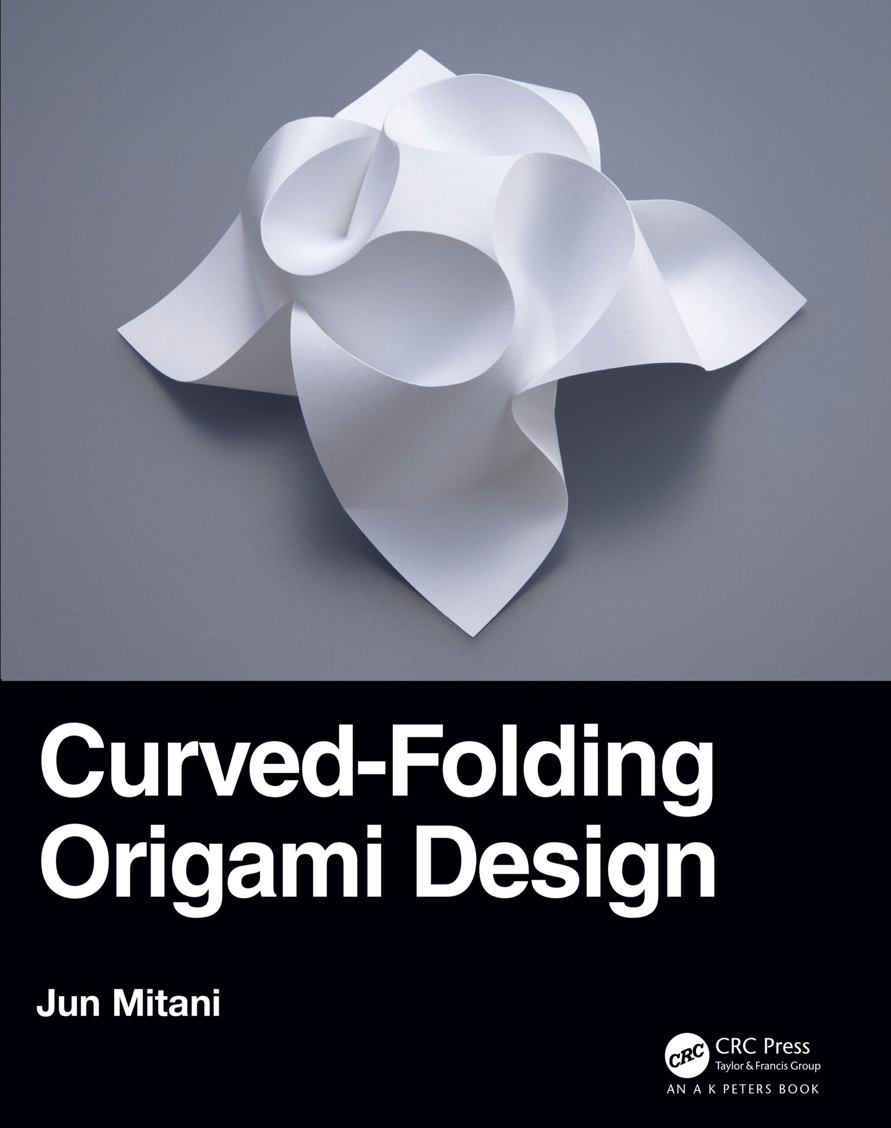
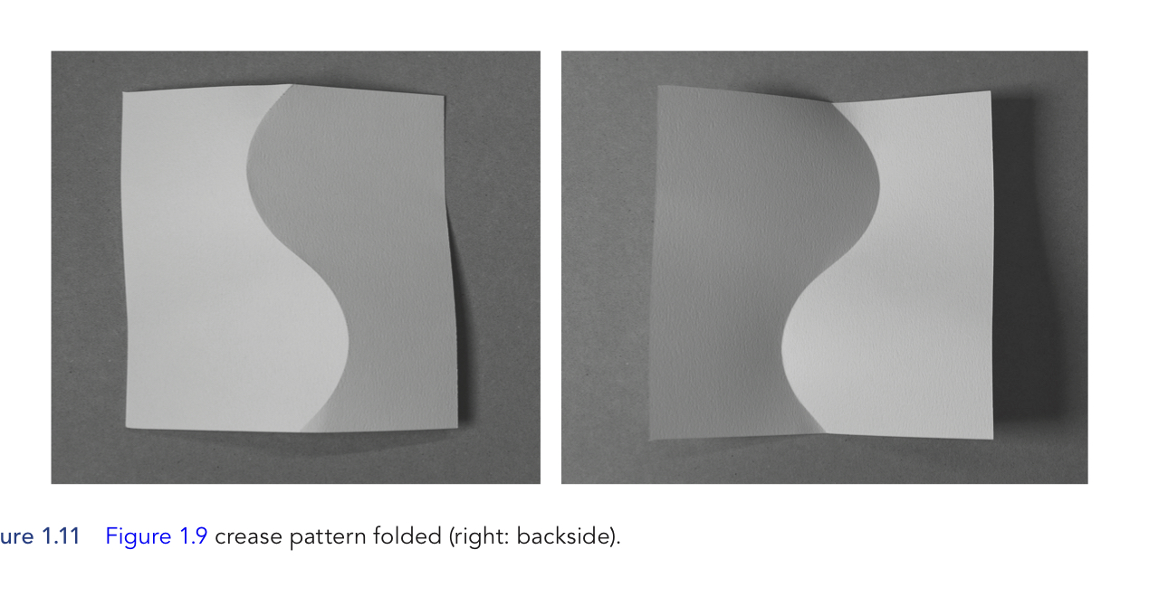
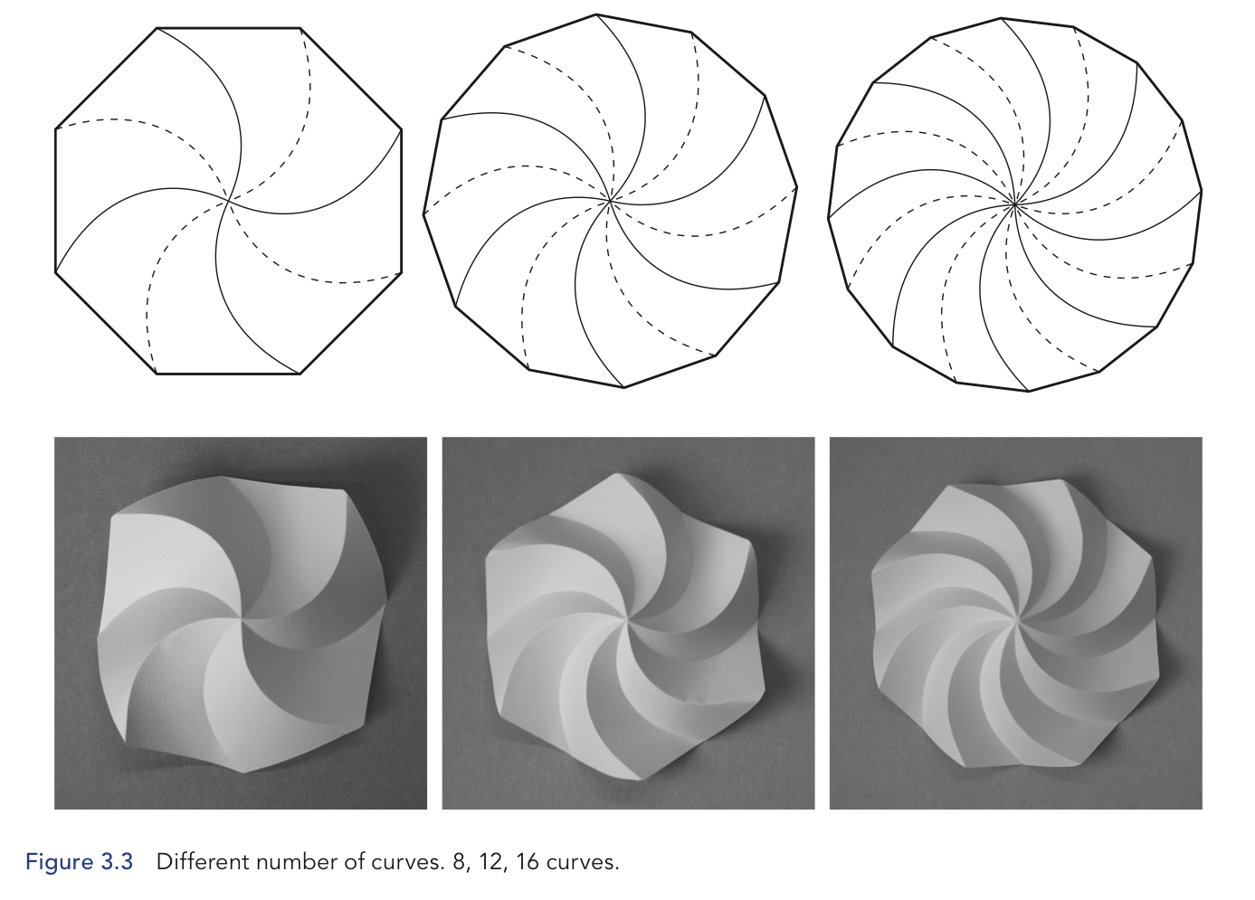
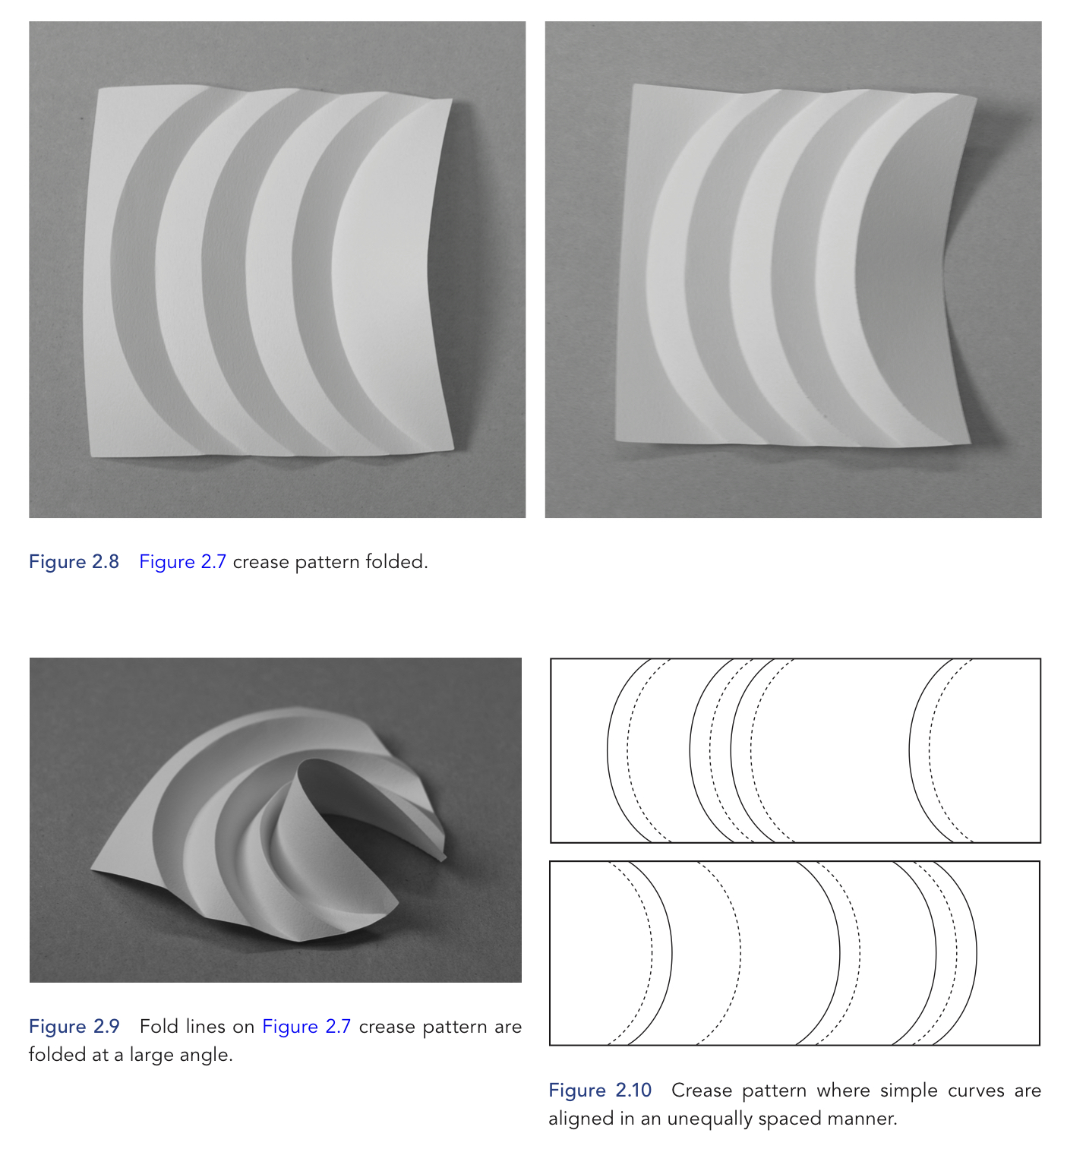
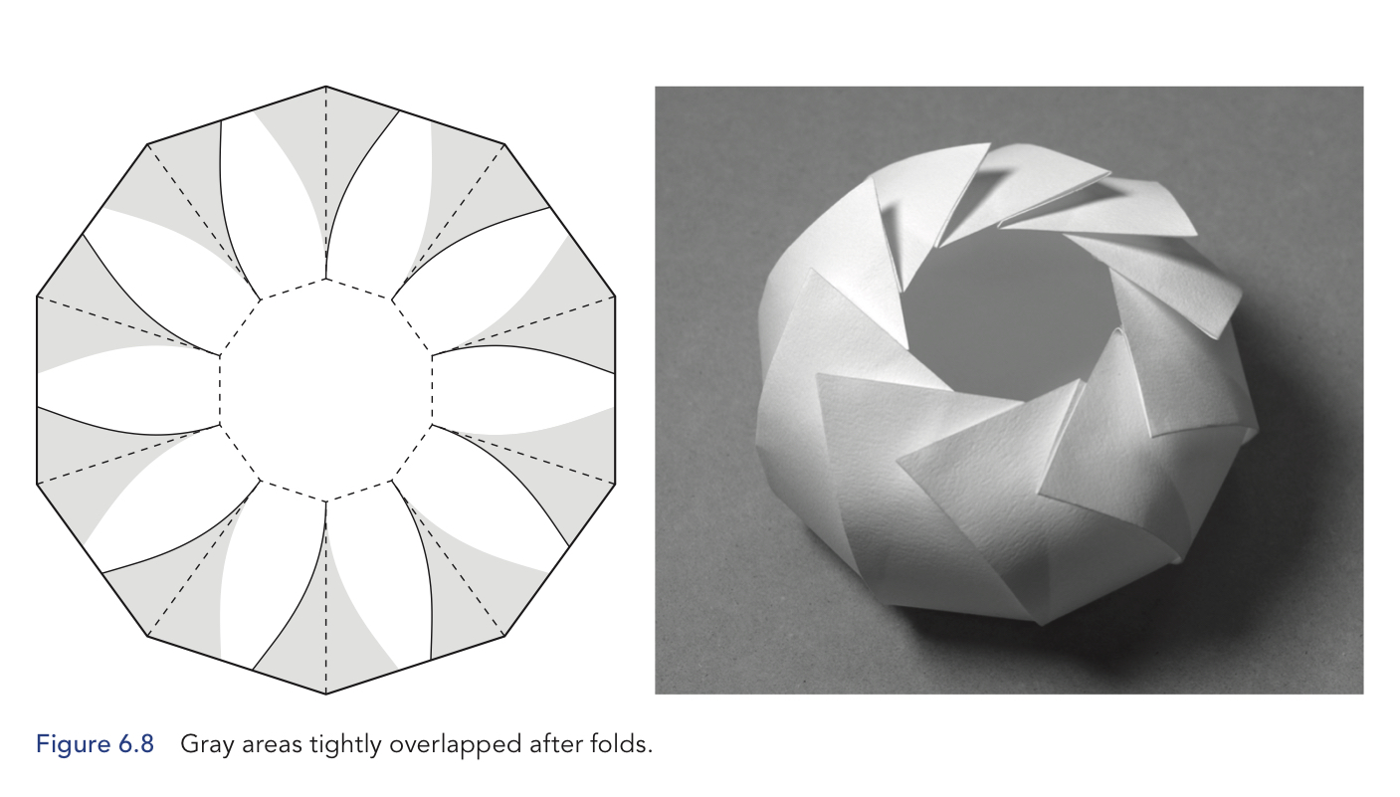
Origami Curves
Notes:
Somewhere in there, I found curved crease origami. The results are so otherworldly and beautiful.
Curves break the origami rules, it can’t be flat
Curved-crease origami makes 3d shapes
But the curves have to be pretty precise so the patterns tend to be generated via computer.
David Huffman (of Huffman codes!) was big into curved origami.
One of the odd things about curved crease is that you
Have to prescore the paper, fold along the score and then get wonderful results.
This isn’t an option, I did prescoring my printing out patterns and then using a ballpoint pen to ink over them
And then I use a protractor.
And then I got a Cricut, a hobby cutter/scorer/engraver.
I made popup cards and vinyl stickers. And I’ve made so much origami.

Slide 7
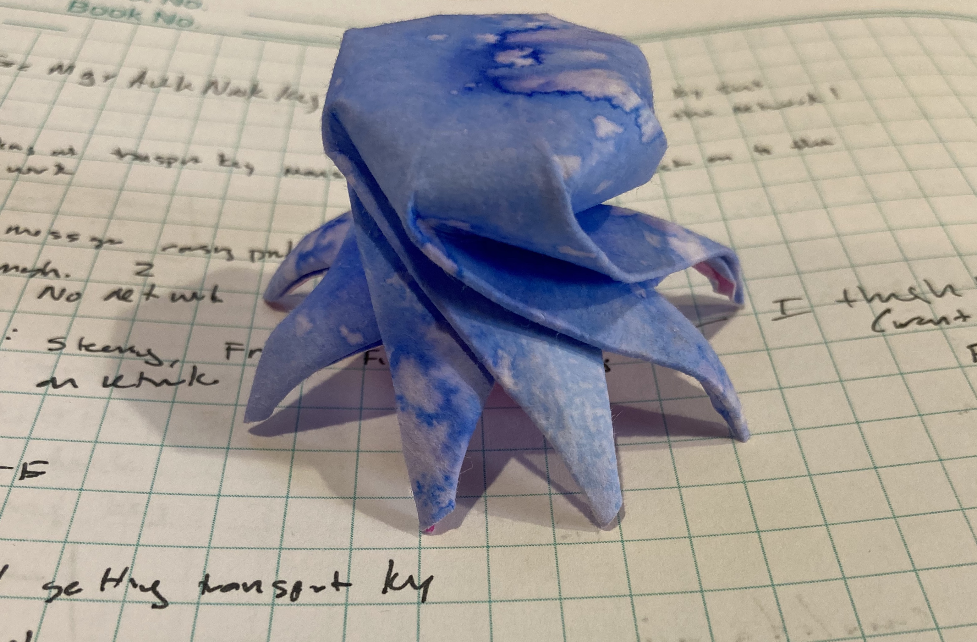
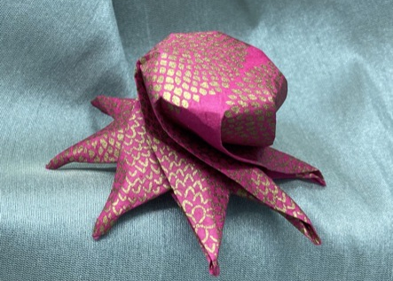
My Curved Crease Octopus
I know, I said no cephalopods.
Notes:
By this point, I was looking beyond folding what other people did and start designing my own patterns.
This octopus pattern isn’t too difficult to fold… I don’t think. I mean other people have successfully done it so I think it is ok.
I got a book about folding sea creature so I could make an origami aquarium, friends for my octopi.
One of the creatures was a nautilus and I couldn’t fold it.
Step 22 just killed me. And that irritated me.
When I noticed a failed cuved crease bowl project looks like a shell after I accidentally cut it in half, well…
I tried to make a shell pattern
and it worked… sort of.
No one else could fold it
because it was 85% made of my
‘this is going to look like a shell, dang it”
Happily, my husband Chris ordered a book
I’d been wanting
and (three months later)
it finally arrived from Germany.

Slide 8
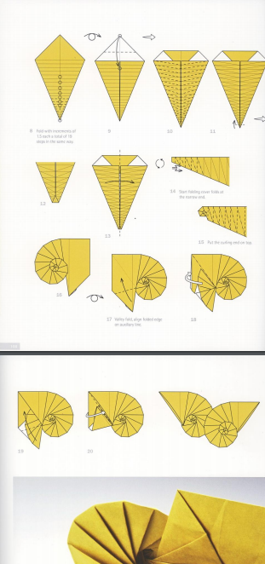
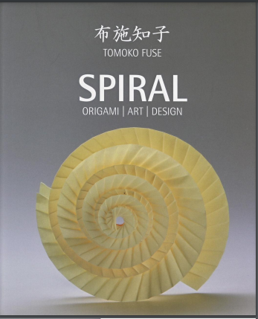
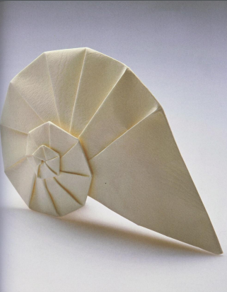
Origami
Tomoko Fuse’s Spirals: Navel Shell
Notes:
Tomoko Fuse is a super famous origami artist. I’m surprised you haven’t heard of her.
Anyway, she does a lot of things with spirals, has a whole book about them. And another book about spirals and boxes which is really neat but not on topic.
Anyway, she had this navel shell which is nice looking.
Note these are pics from her book, mine are not this elegant.
Also, 300 pages later, I understand how to make that nautilus but
I no longer care about the sea creatures book because now I need all the snails.

Slide 9
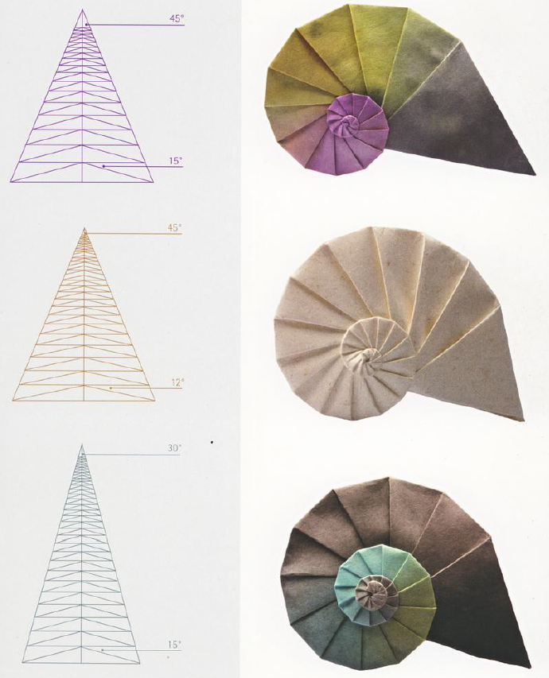
Triangles
Notes:
(Show book live?)
I think this was the page that did me in.
Angles, triangle, modifying geometry to get different structure.
They are subtle but a larger central angle (top angle) leads to a large body whorl and smaller protoconch.
A larger spirality angle (the smaller angle) causes the spiral to grow more quickly, leading to a blockier, less rounded form.
I didn’t choose those names, they are from Tomoko Fuse’s book.
But remember back to Raup and his W which described how fast the snail grew?
And T which is related to how much of the old whorl was covered by the new

Slide 10
Folding Triangles
Pic of stages
Notes:
(Show these live)
To fold these, you
Print out the pattern, cut the shape.
Fold all the horizontals one way, we’ll call this mountain
Fold all the diagonals the other way, we’ll call this valley
Then do an inside reverse fold at the tip.
No, seriously, you just follow the creases and make a little tip
Then you keep folding back and forth
And then you get to the point where the tip is going to get hidden, you push it out
Which makes folding things on that side a bit tricker as you have to tuck things into the body whorl
And then, viola, you have a snail.

Slide 11
Programming
https://github.com/eleciawhite/origami
Notes:
I wanted to reproduce the images Fuse’s Spiral’s book.
And from curved creases,
I’d gotten accustomed to precreaing
which makes folding straight lines easier,
especially if they have to be precise
I knew I’d use Python and matplotlib because I use that quite a lot for data wrangling.
Still, how do you make a triangle with a bunch of horizontal lines and some more triangles inside

Slide 12
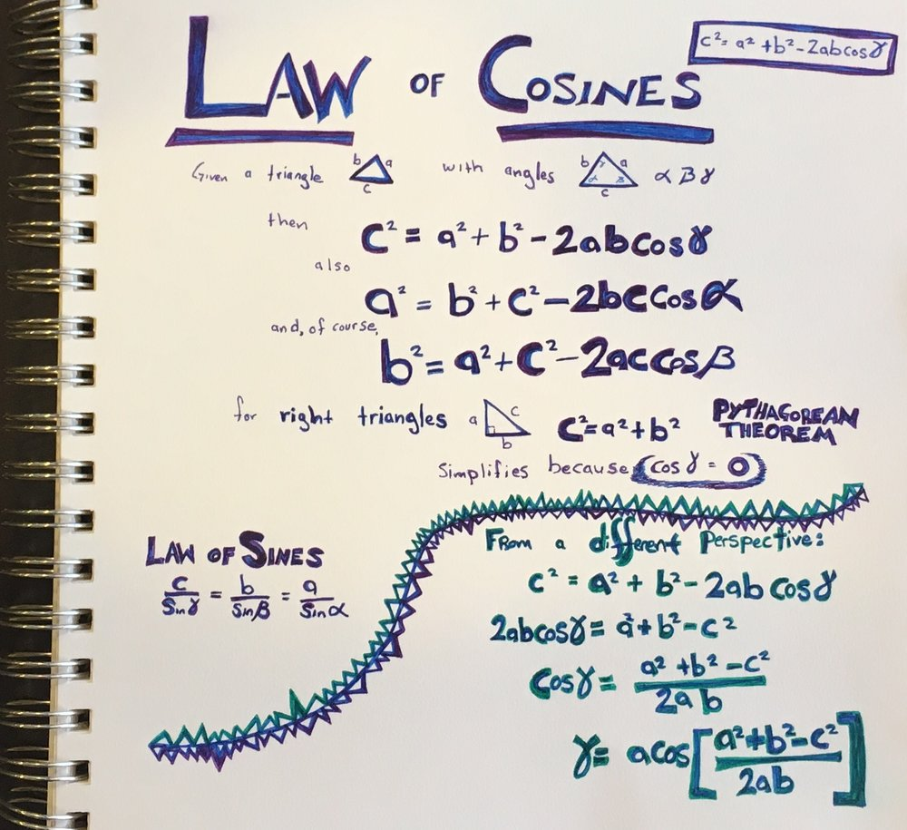
Programming Triangles
Step 1: Hope
Step 2: Fear
Step 3: Bargaining
….
Step 99: Geometry, specifically trigonometry
Notes:
Short detour for a complaint about our math education?
Why do we focus so much on the Pythagorean theorem and right triangles?
The Law of Cosines works on any triable and it is so much better.
Though really all I needed was the law of sines
but I didn’t know that before 20 pages of geometry
in which I reinvented the law of sines.
I didn’t make this sheet for this talk or for origami snails,
it is left over from working on robot kinematics…
just in case you ever wondered about the degrees of separation between robot arms and paper snails.

Slide 13
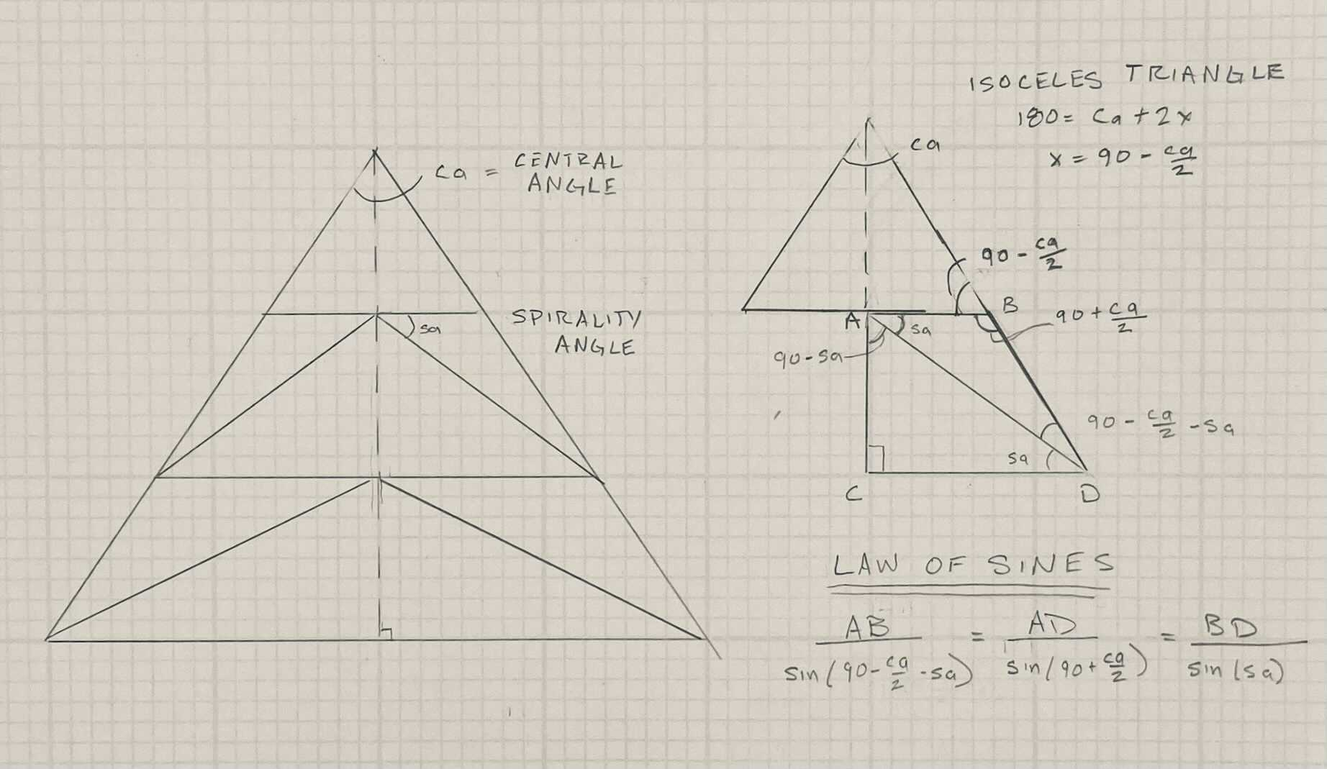
Develop the Navel Algorithm
Is this really an algorithm?
I’m just creating a triangle
Then adding a line with some other triangles
Then repeatedly adding another line until the end.
And then containing the triangle in an outer polygon.
Notes:
Despite robot projects,
I was very rusty and needed a few tries at the math parts.
But I had two of three angles which meant I could get all three.
Then I had to just choose a length and everything else fell out.
I chose the initial horizontal length to be one. Because, really, isn’t that secretly your favorite number?
Once I had one horizontal line with its two triangles, I could go down to the next one.

Slide 14
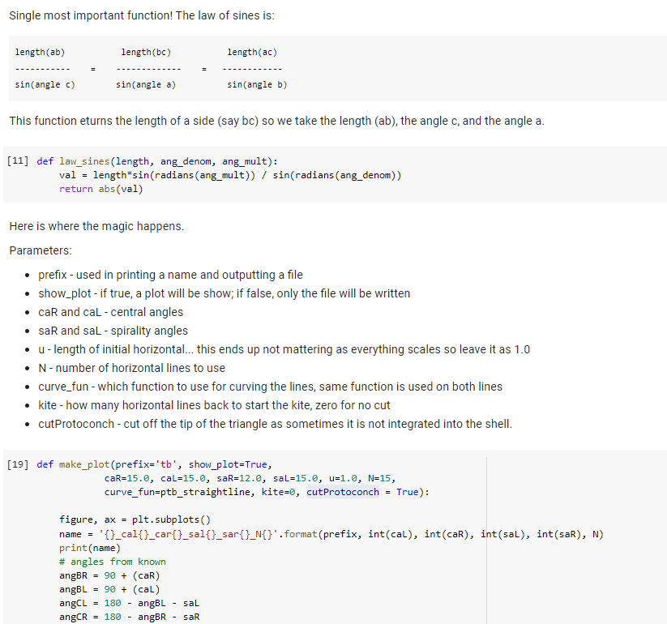
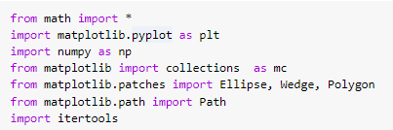
Python
https://github.com/eleciawhite/origami
There is also an online colab (like Jupyter) so you don’t need to install anything.
Notes:
I’m not going to go over the code with you.
But I will say that there is a colab which is a way to intersperse code and text.
It is like Jupyter notebooks but online so you don’t have to install anything.

Slide 15
Fuse-Style Navel Shells
Image the pattern, snails, calling function
Notes:
(live show snails)
So, mission accomplished, we have patterns, easy to generate.
Here we have a pattern, a snail folded in on itself and a snail that is pulled out like the Fuse ones are.
But, you know what is kind of lame? That step where you have to pull out the protoconch.
It seems like the snails shouldn’t be flat, that they should be conical.
Flat snails seems like a really bad idea.
“Flat Snails” seems like a

Slide 16
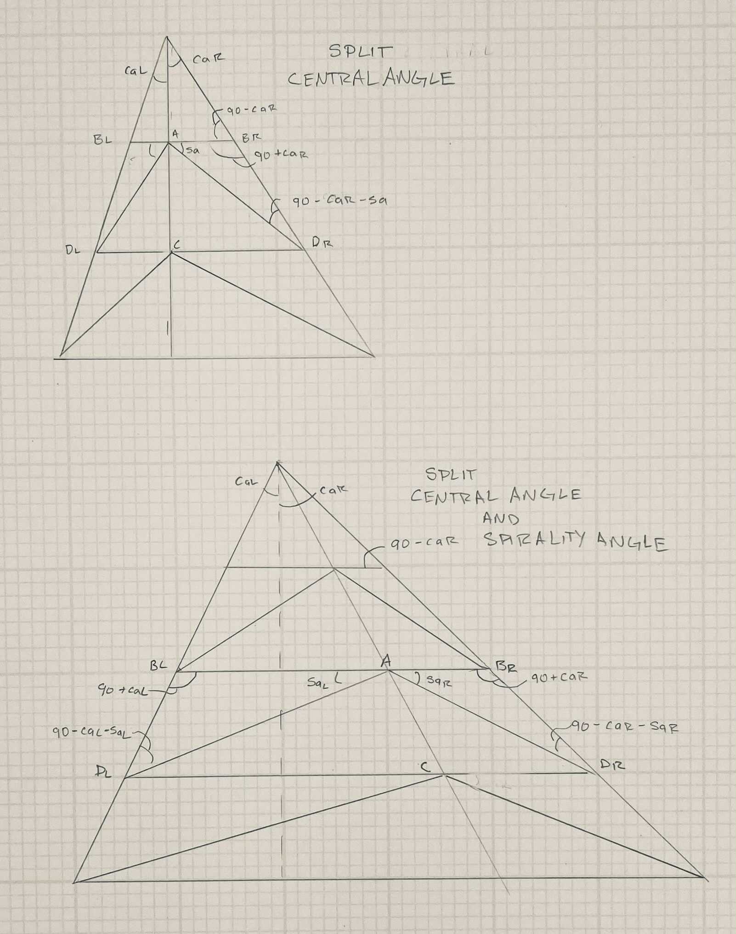
More Geometry
This is no way to lead your life.
Though maybe it is.
I mean, I felt pretty good about myself after doing math. Like I was smart and stuff.
You know, Ada Lovelace used to do calculus problems for fun. When I heard that I thought that sounded interesting and wished I could do it.
Then I realized… no one is stopping me. Except me.
Notes:
It seems like there might be a better way.
What if the central angle wasn’t balanced?
What if the spirality angles weren’t balanced?
Why do I spend so much of my free time doing geometry?

Slide 17
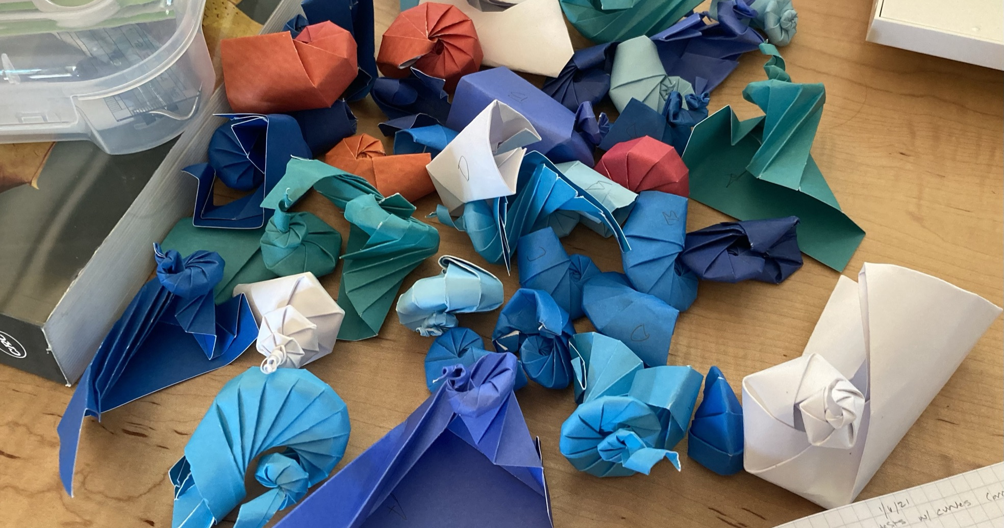
Notes:
Evolution is cruel and there are many parameters that do not work. Many, many.

Slide 18
Unbalanced Snails
Image, the snails at different parameters
Notes:
(Live show snails)
One neat thing here, now that the parameters aren’t balanced is that we get the idea of chirality, are they curling left or right.
Snails are hermaphrodites, their bits have to line up and they don’t unless the shells are going to the same direction. Just a snail fact I thought you should know.

Slide 19
Pretty good
Snail with the parameters
Notes:
(Live snail)
Putting it all together we get a pretty good turbinate snail.
Chunky but we know if we decrease spirality, the snail will grow slower and be smoother.
But wait… what if we add in curves?
What if we replace the straight lines with Bezier curves?

Slide 20
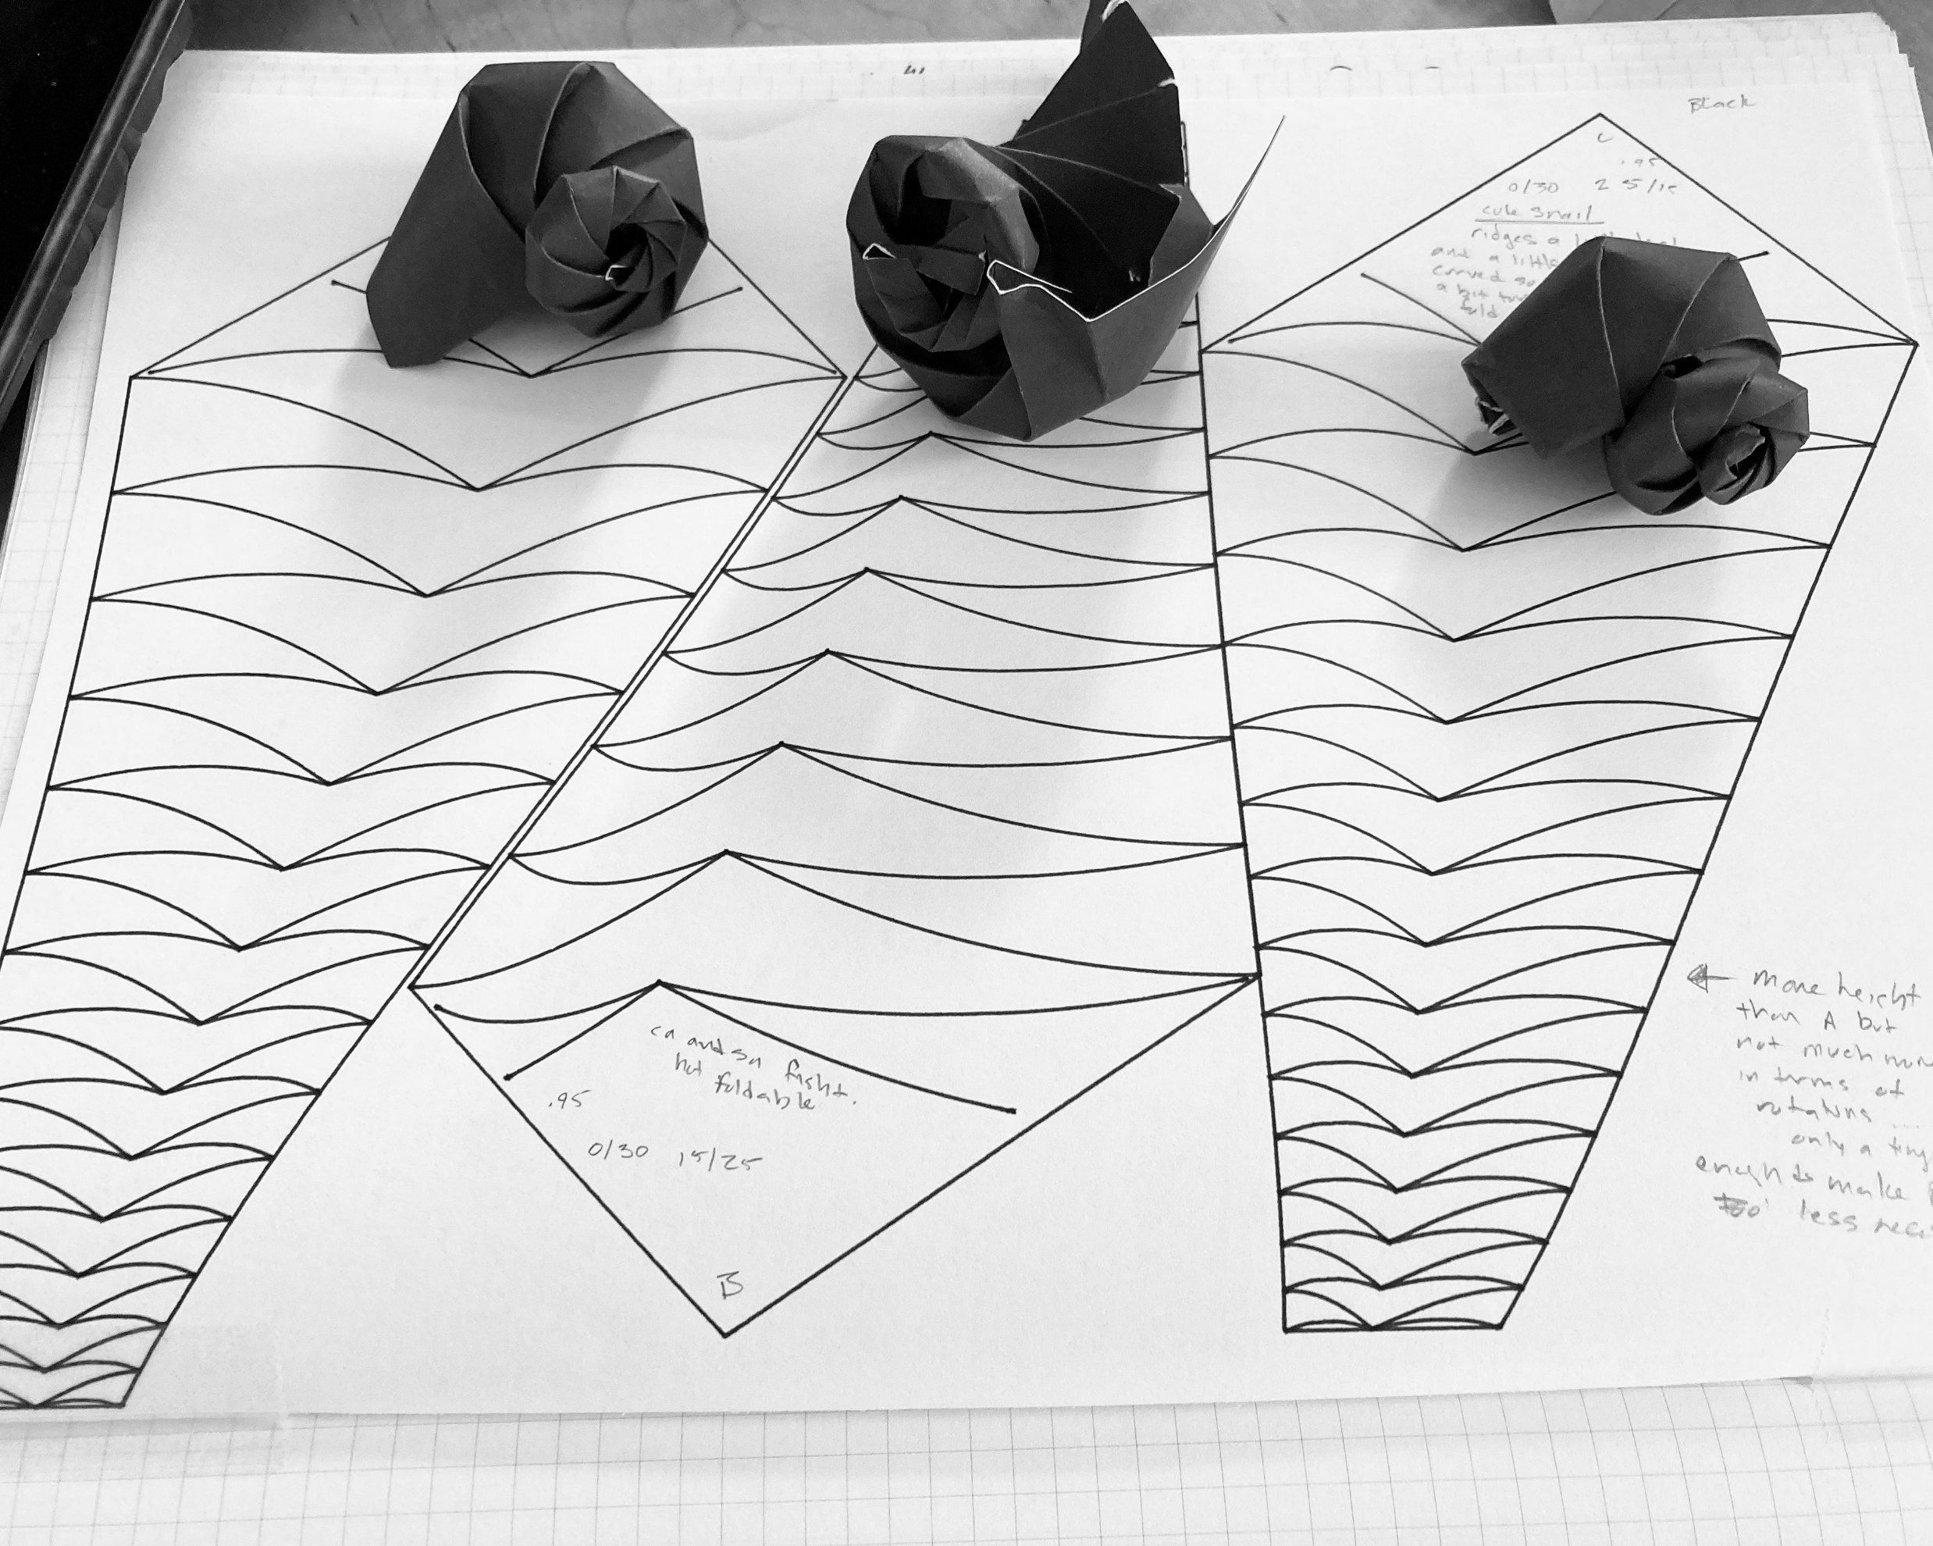
Curved Crease Snails
Notes:
Plenty of parameters that don’t really work.
The folding here is more difficult.
The paper is a pain.
Curved crease origami is easier done with cardstock.

Slide 21
Copy Paper Snail
Notes:
I mention curved crease and cardstock
so you can be suitably impressed that all the white snails I’m showing are made of copy paper.
Ehn, I know you aren’t suitably impressed but let me tell you, origami people would be wow’ing right now.
Though they are such snobs out paper, maybe they’d be closing their Zoom windows instead…
Anyway, I used copy paper instead of something fancier so you know
you can make these, either make your own by running the script or get a working SVG from me.
I had kind of hoped to fold one together as we talked but…
but ten minutes.
Also, I realized I’d be the one talking,
I usually only fold in meetings when other people are talking. And my camera is off.

Slide 22
More Paper Snails
Notes:
Anyway, copy paper is hard, cardstock is easier
I can do planispiral as well, nice nautilus that curls in on itself.

Slide 23
Next: Conches
Notes:
Generating function is no longer a circle
Much harder

Slide 24
About Me: Elecia (Engelman) White ‘96
I’m an embedded software engineer; I write software for things that aren’t computers. The applications are endless.
I’m a consultant and my company is Logical Elegance, Inc.
I did a Mudd Individual Program of Study: applied CS and theoretical engineering (programming and Fourier). I concentrated in art and theories of learning.
I wrote O’Reilly’s Making Embedded Systems, a great-eared nightjar.
With CW ‘96, I host a podcast called Embedded where we talk about engineering, art, and teaching. And sometimes embedded systems.
I really like snails. And origami. And robots.

Slide 25
Sources
Mollusk Morphology
Computer as Aid in Describing Form in Gastropod Shells. Raup, David M, 1962.
Geometric Analysis of Shell Coiling. Raup, David M, 1966.
A Natural History of Shells. Vermeij, Geerat J, 1993.
Snail Facts
Spirals in Time: The Secret Life and Curious Afterlife of Seashells. Scales, Helen, 2015.
Origami Books:
Tomoko Fuse: Spirals
Jun Mitani: Curved Folding Origami Design
https://github.com/eleciawhite/origami (colab)

Slide 26
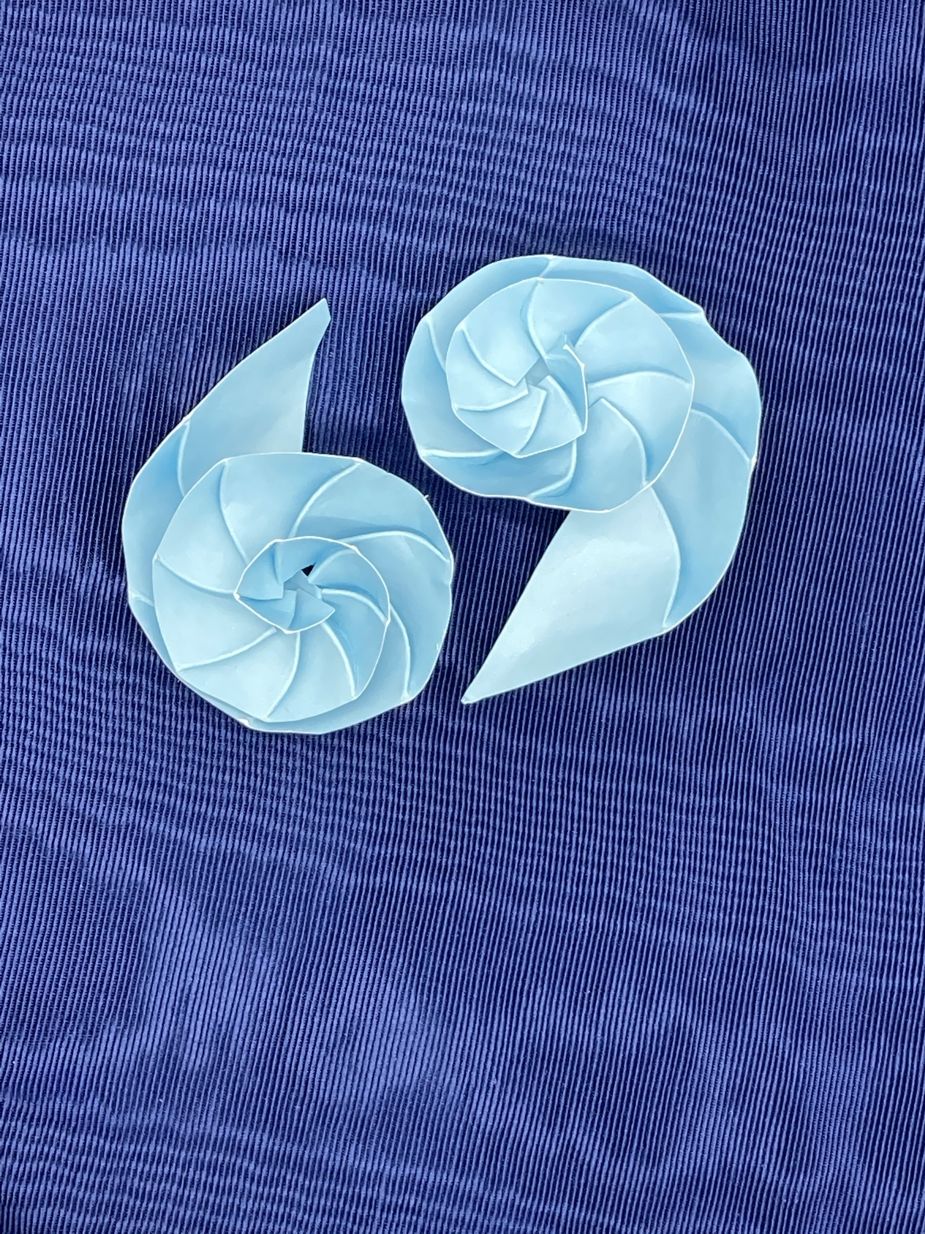
Ammonite Half-shell
Notes:
Easy to fold, cut a planispiral origami pattern in half.
Easier to do that than to cut an actual snail in half.

Slide 27
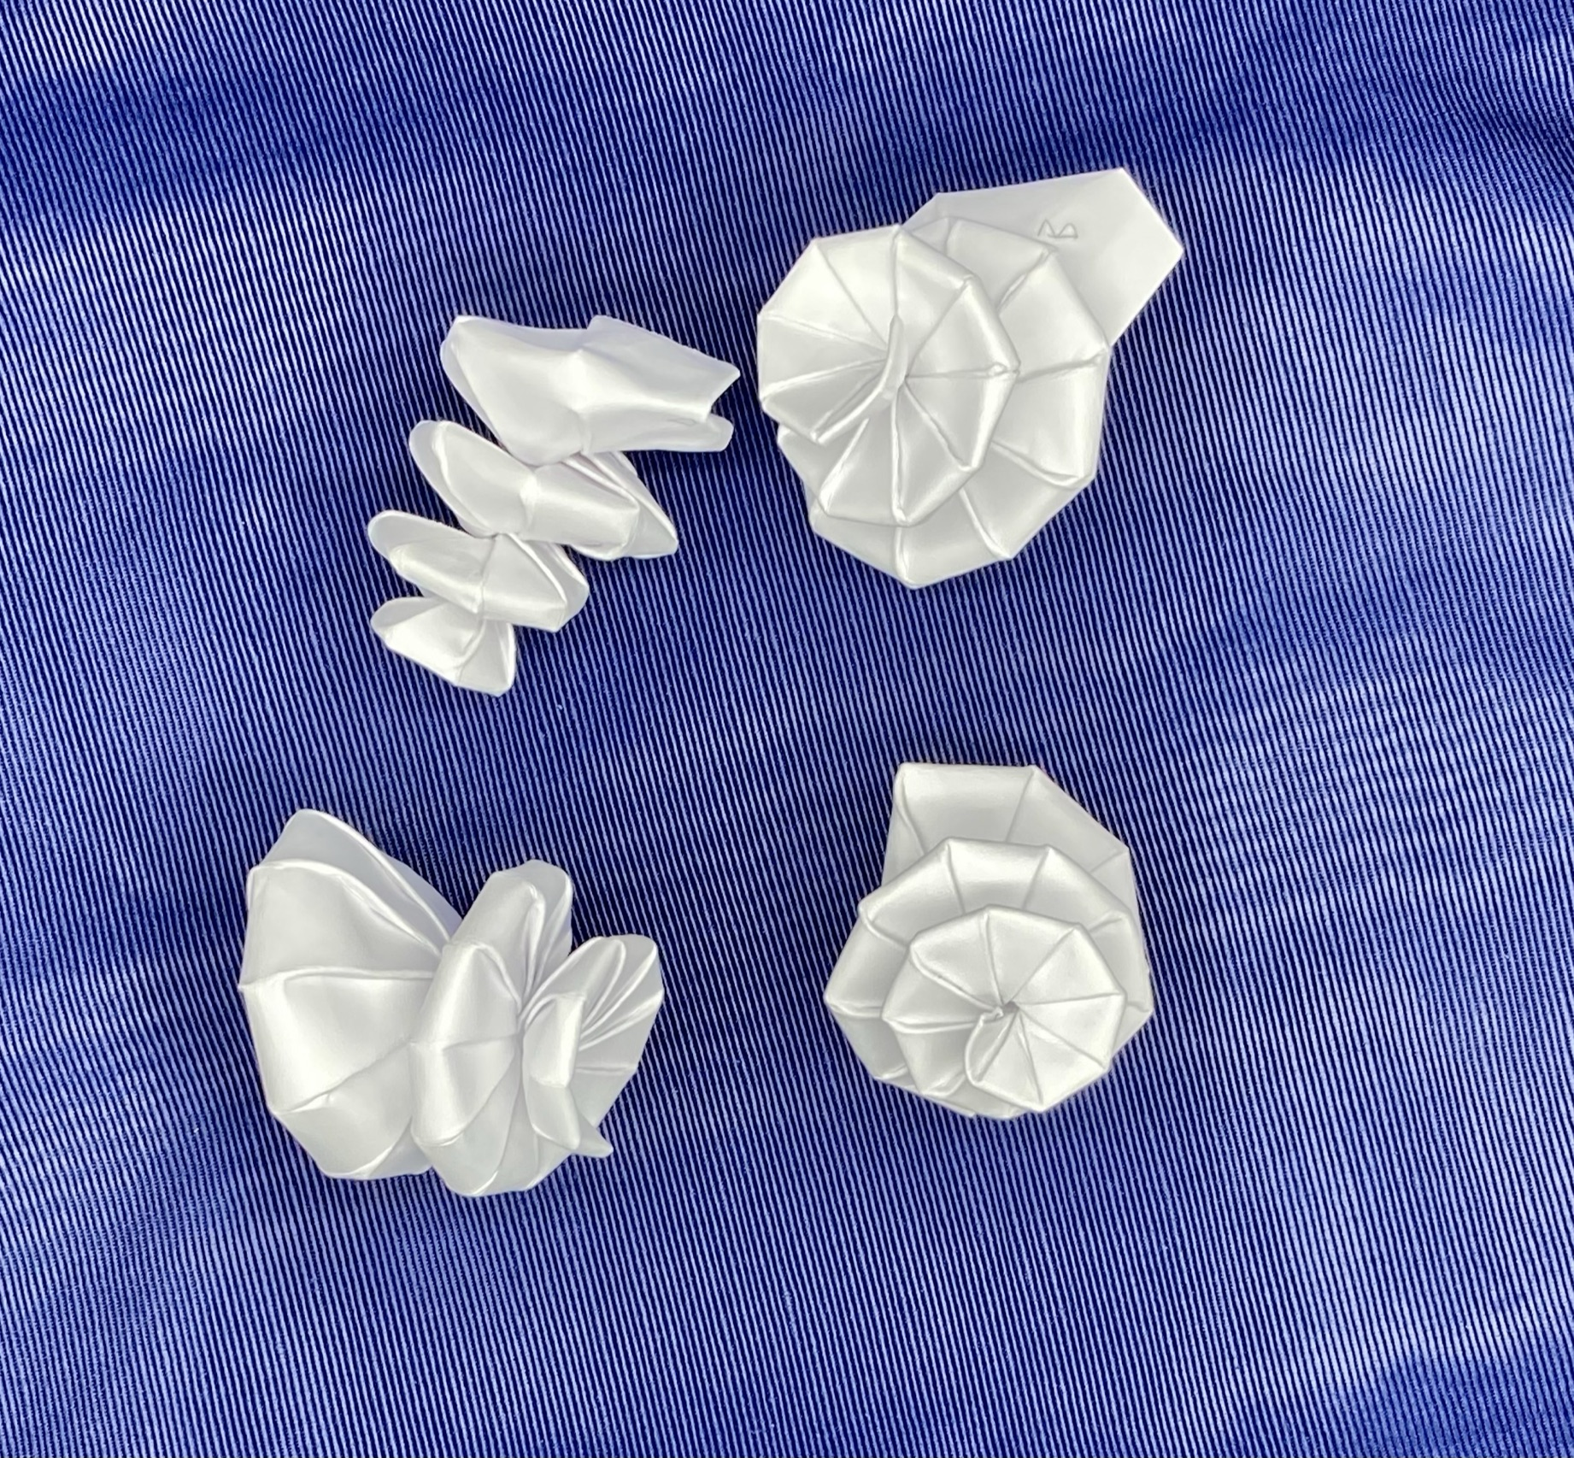
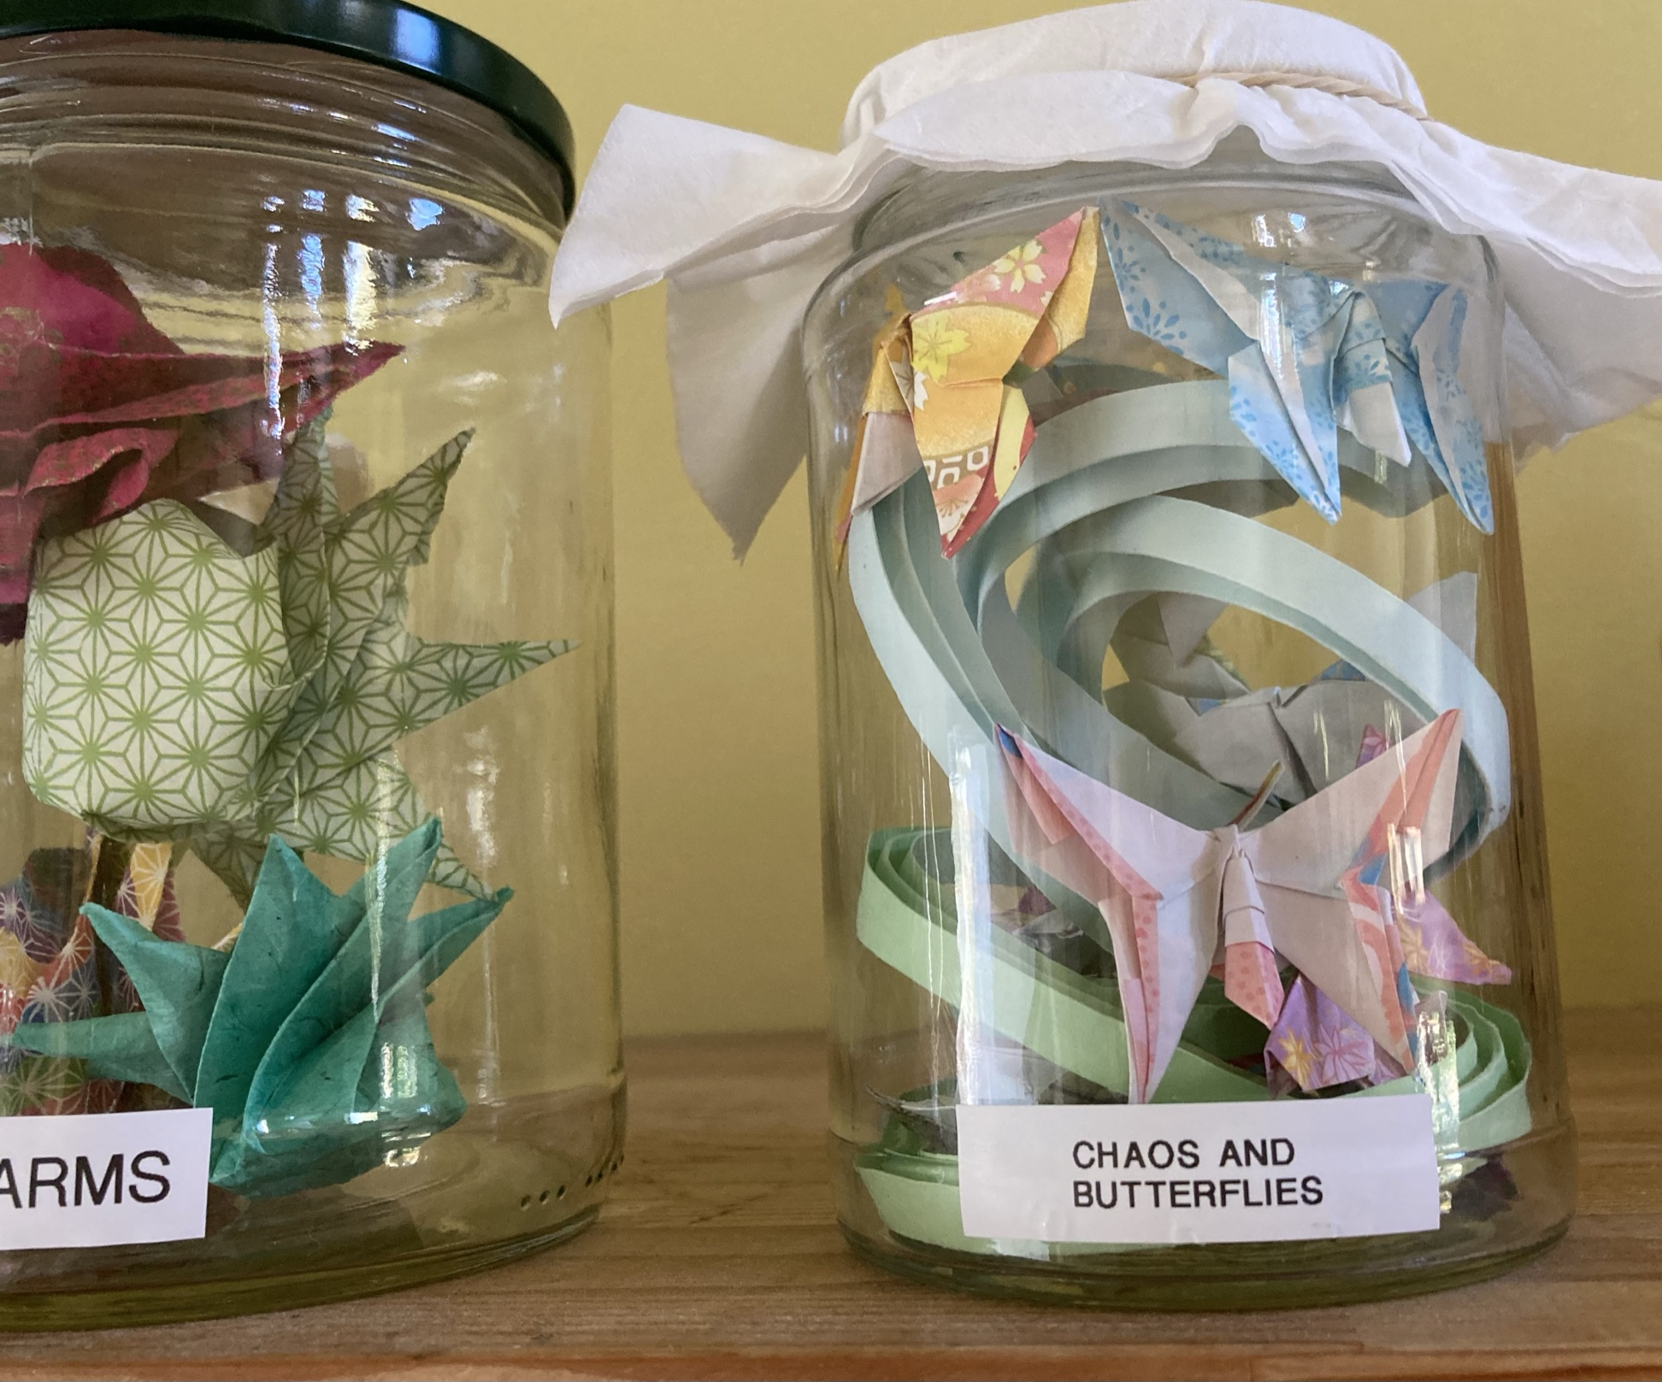
?
Notes:
Really neat failures. Pushing the Bezier curves as far as the paper will let them go

Slide 28
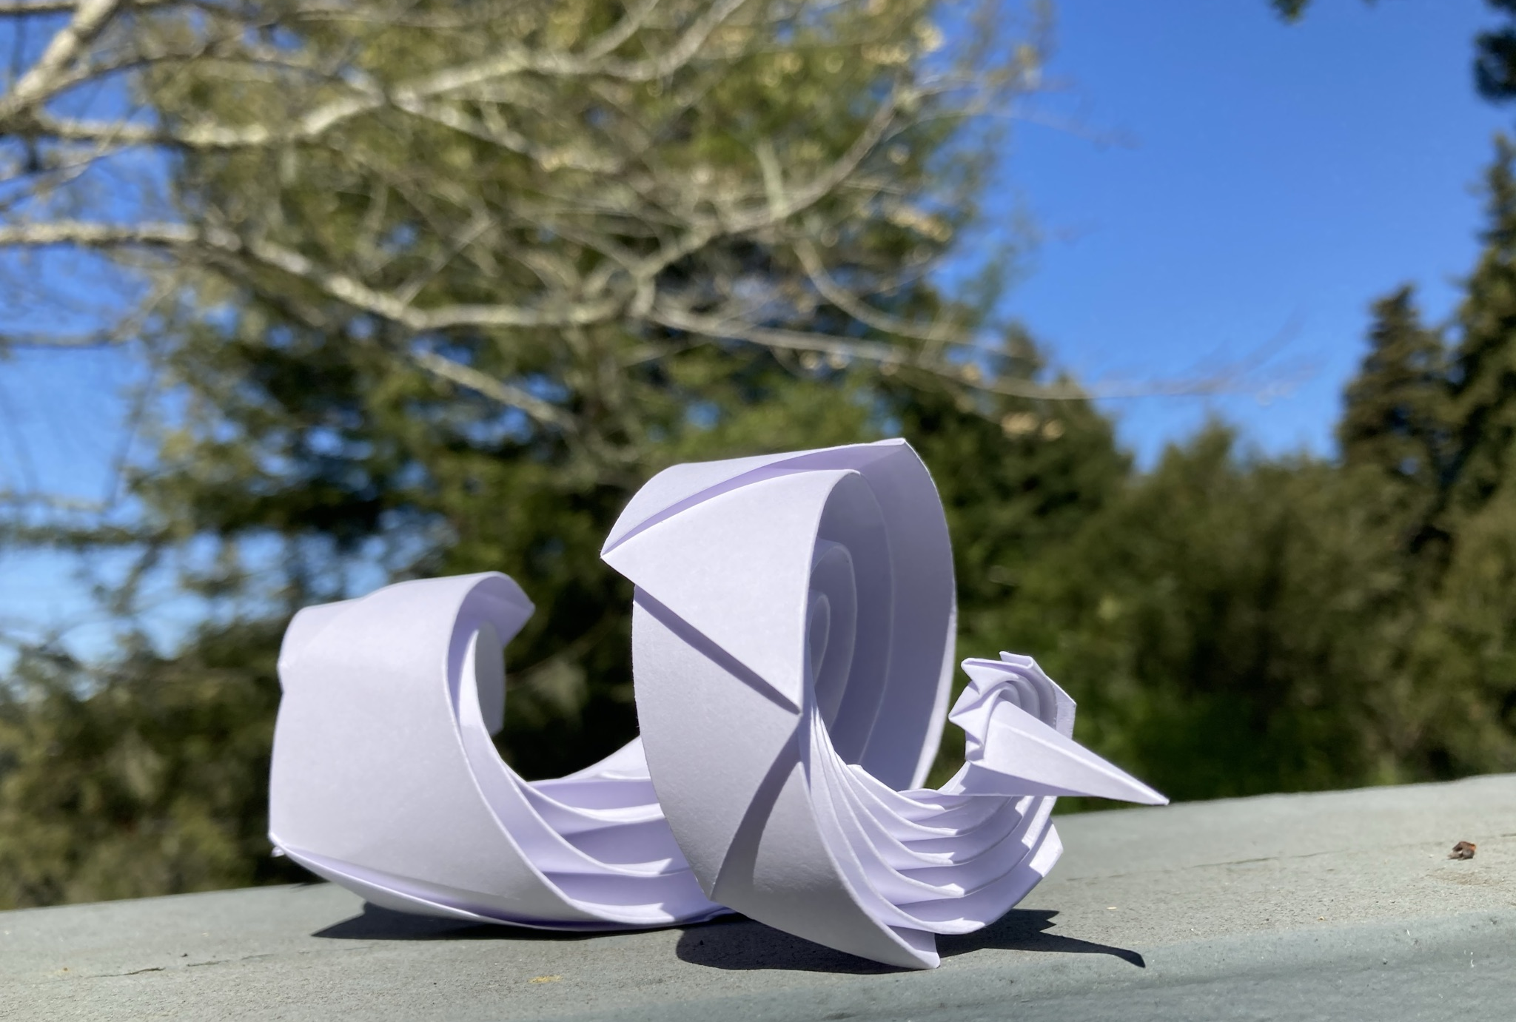
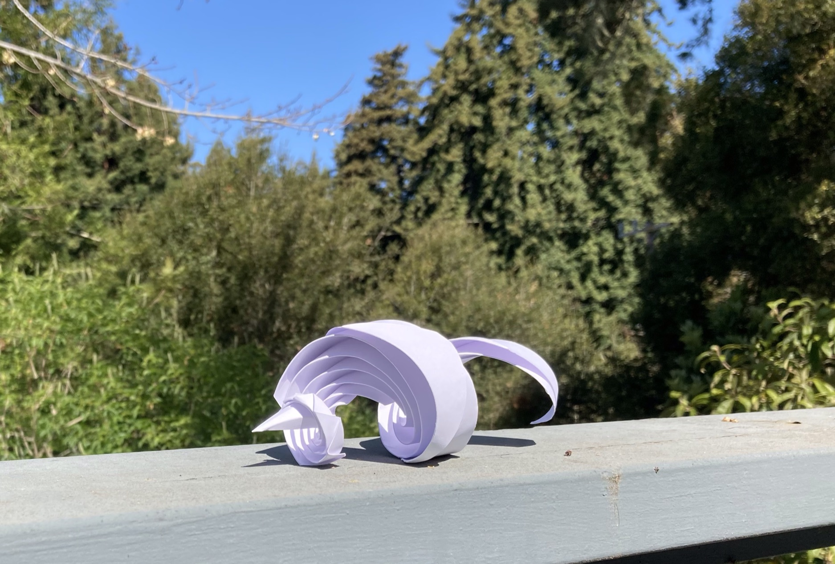
Luck Dragon
Curved crease and pleated
Notes:
Totally an accident

